Slide 1




Automatic Labeling For Welding Images
Tutor: Pr. GABER Jaafar
Team: BAMFO Kwabena
BOU ABBOUD Mario
University: Université Franche-Comté, STGI
Major: Internet Of Things: NETWORKS And MOBILITY Bac +5
Subject: Master 2 Final Project
Keywords:
Industry 4.0
Deep Learning
Image Processing
Computer Vision

Slide 2

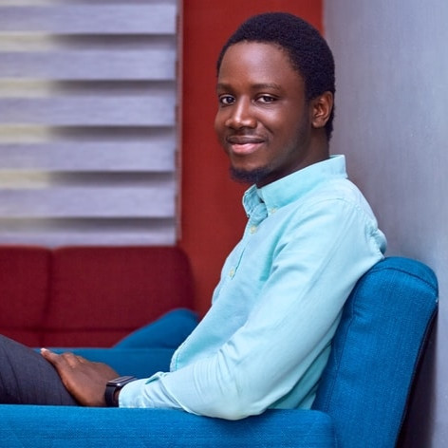


The Team
Mario BOU ABBOUD
Kwabena BAMFO
Prof. Jaafar GABER
Instructor
Theo SAIFY
Faurecia's Representative

Slide 3
Overview
Introduction
Introduction To Industrial Welding
Robotic Welding Today
Inaccurate Welding Problem
State Of The Art
Laser Tracking, Image Processing Tools, Machine Learning
Current Implemented Solution
Project’s Objectives
Automatic Annotator/Labeler
Easy To Use interface
Challenges
Our Solution: Improved Canny Edge Detector + CNN
Solution’s Architecture
Scenarios
Hardware Architectural Diagram
Software Architectural Diagram
GANTT
Sequence Diagrams
Proof Of Concept
Algorithmic Implementation
Results: Accuracy, Performance
Live Demo
Conclusion: Experience, Skills, Application in IOT

Slide 4
Introduction

Slide 5
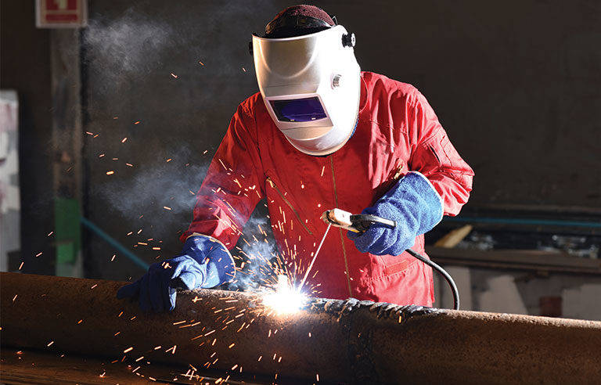
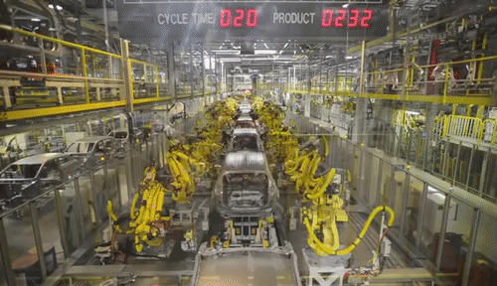
Introduction to industrial welding
Welding is the process that joins materials, usually metals, by using high heat to melt the parts together causing fusion
Production line is a set of sequential operations established in a factory where components are assembled to produce an end-product that is suitable for onward consumption
Robotic arm is a type of a programmable mechanical arm, with similar functions to a human arm

Slide 6
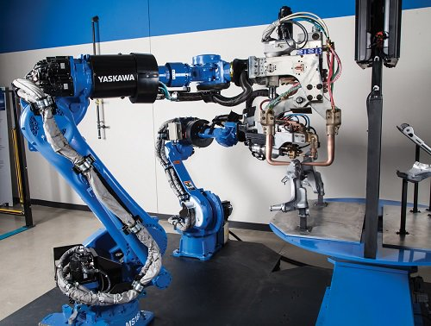
Robotic Welding Today
Manufacturing production is experiencing its sharpest increase since June 2012 with output rising by 3.1% year on year
11,000 robots shipped throughout North America in the first part of 2018, spot welding applications accounts for 27% of units sold and arc welding for 16%
The use of robotic welding for mid- to high-volume manufacturing has become more widespread because of benefits such as:
Better quality
Improved consistency
Combined with a variety of technical advancements
Robotic Welding Market is predicted to hit USD 8.31 Billion by 2027

Slide 7
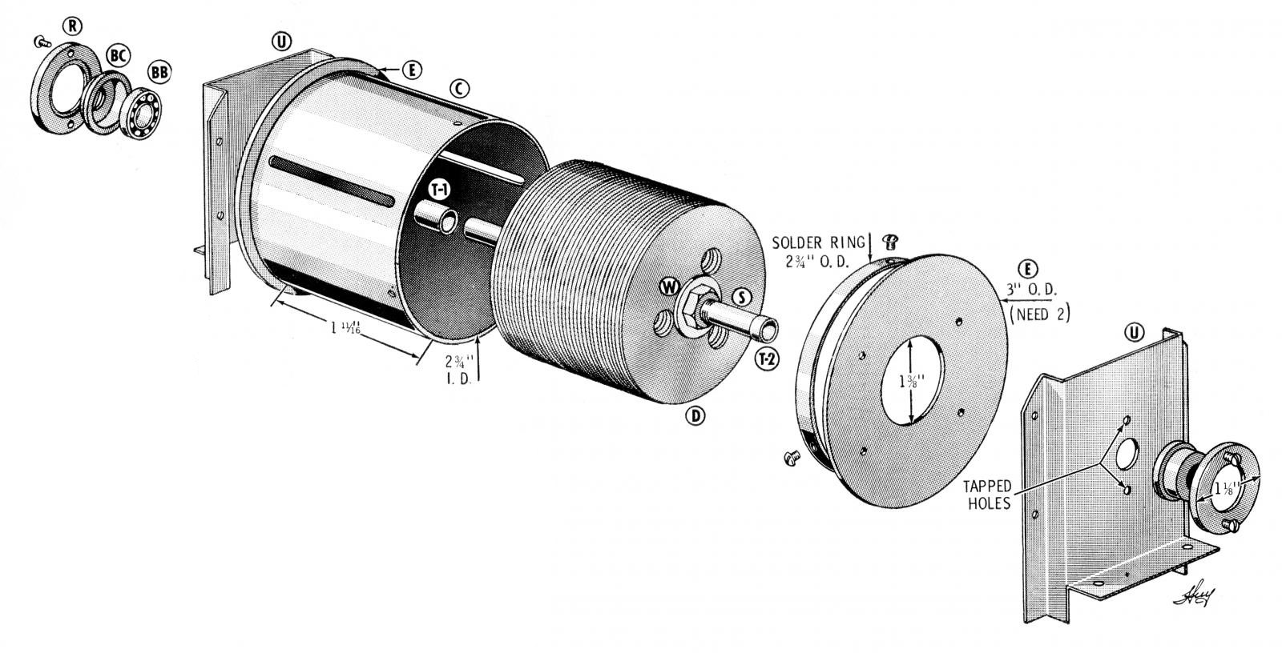
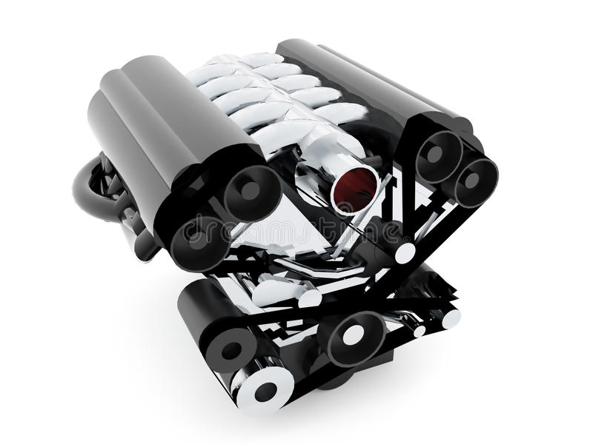


Inaccurate Welding
Workpieces
An object being worked on with a tool or machine
Workpieces are assembled to form components
The Problem
Inaccurate Welding is due to misallocation of Workpieces upon arrival to the welding arm
Workpieces can arrive translated or rotated
Welding arms are hard coded to weld in a specific location

Slide 8
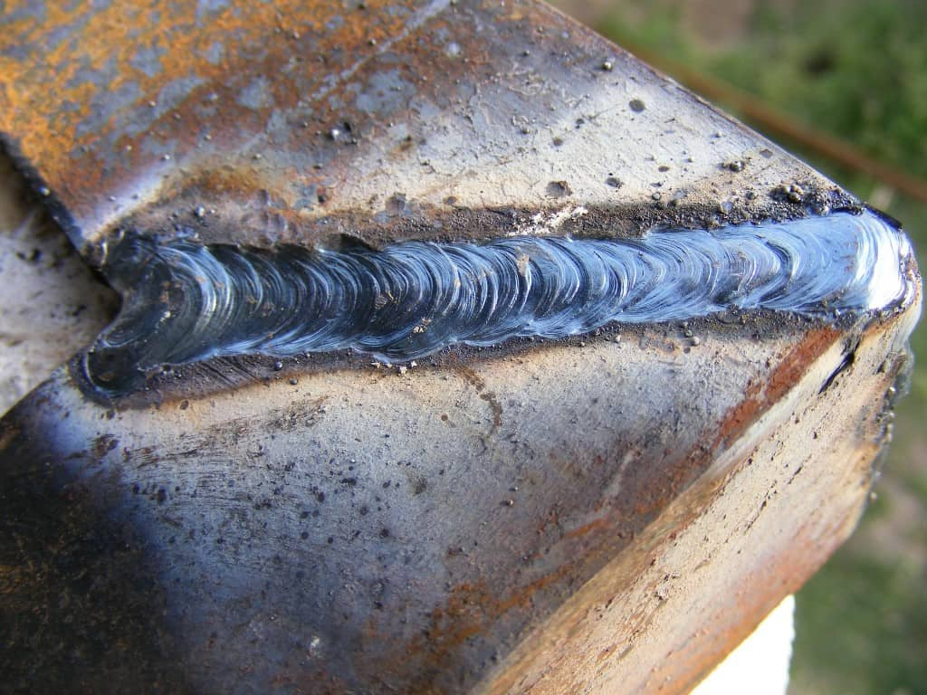
Inaccurate Welding
The Cost
There exist multiple types of welding defects
Porosity
Metal spatter
Incomplete penetrations
Burn-through
Precision
According to Faurecia 7% of units welded have precision defects
Decrease in production speed due to the required intervention
Increase in production cost due to the required human intervention

Slide 9
State Of The Art

Slide 10
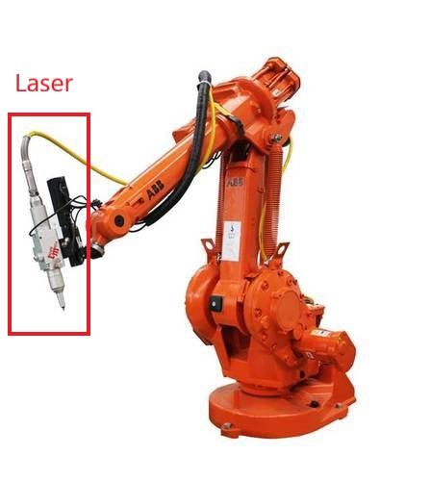
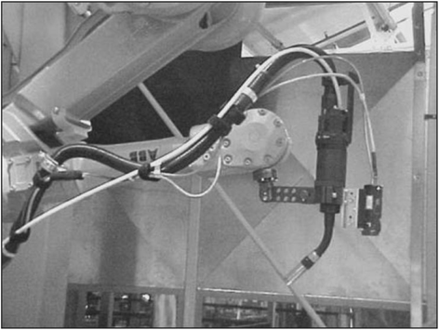
Current State Of The Art Solutions
Laser tracking
Highly Accurate
Widely Adopted
Immune to ambient lighting conditions
Depth detection
Mounting a laser on top of the arm reduces it’s accessibility
Laser reflection off of metal surfaces causes error
ABB 2400–16 robot
with MIG welding torch
and the OST CSS Weld-Sensor

Slide 11
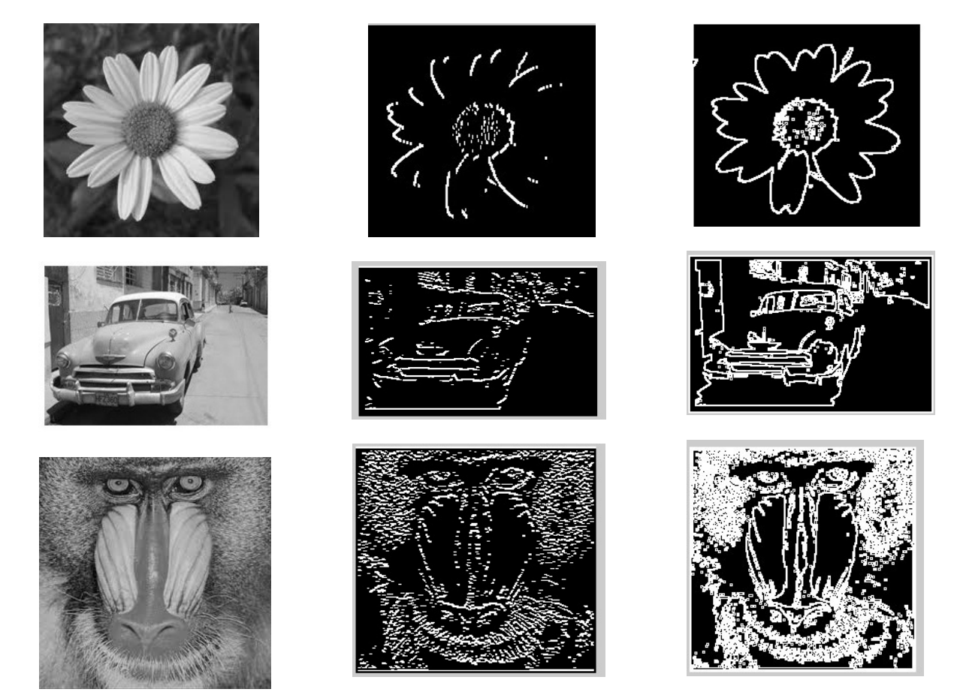
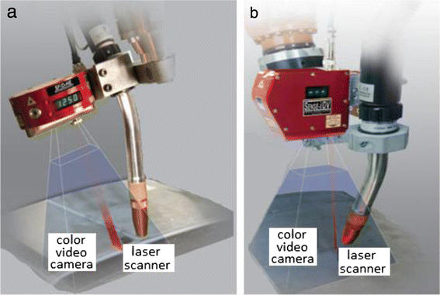
Current State Of The Art Solutions
Image Processing (Sobel/Canny Edge detectors)
Cheap Solution
2D images can’t detect depth
3D Images Requires Computational Power to generate 3D models
Noisy images lead to poor performance
Combination of lasers and cameras
Increased accuracy
Lower error rate
Increased cost

Slide 12
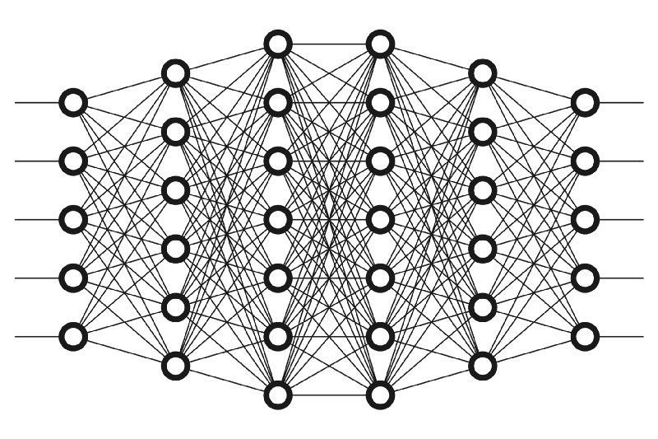
Current State Of The Art Solutions
Machine Learning (CNN)
Cheap Solution
Trainable for low quality images (Distortion, Noise, Bad Lighting conditions)
Requires lots of images to train
Requires Computational Power in the training Stages
Still underdevelopment in academic institutions
Not enough professional data to train models
It combines the accuracy of lasers and sophisticated sensors with the low cost and flexibility of image processing

Slide 13
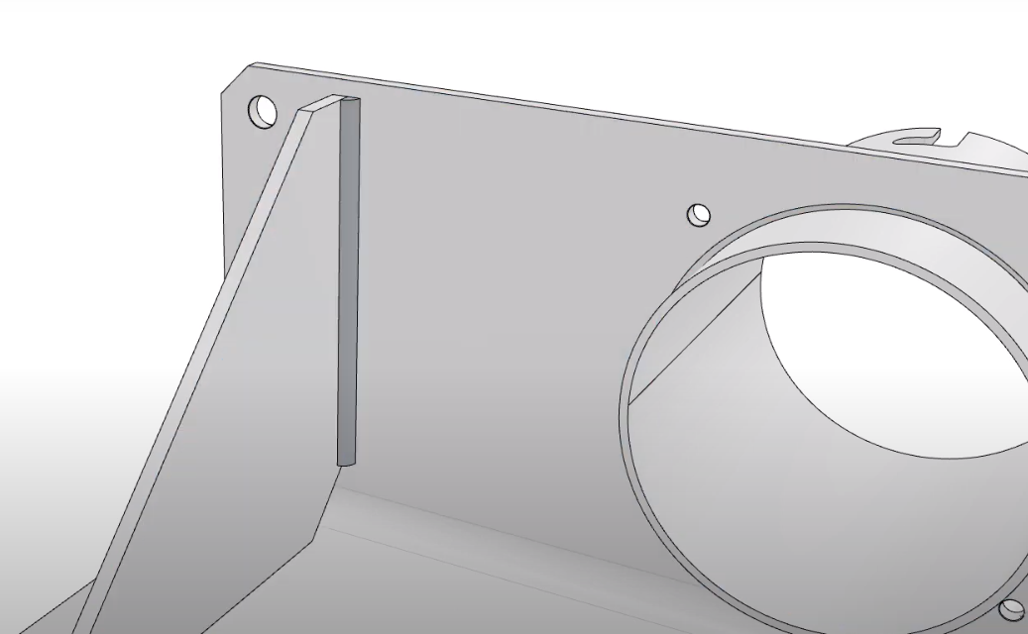
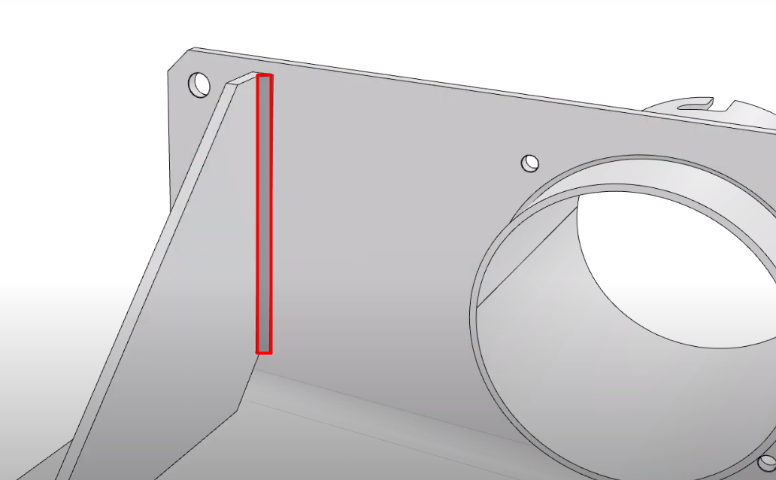
Current State Of The Art
Deep Learning Approach
Take footage of a complex workpiece
Feed it to the model
Identify welding lines

Slide 14
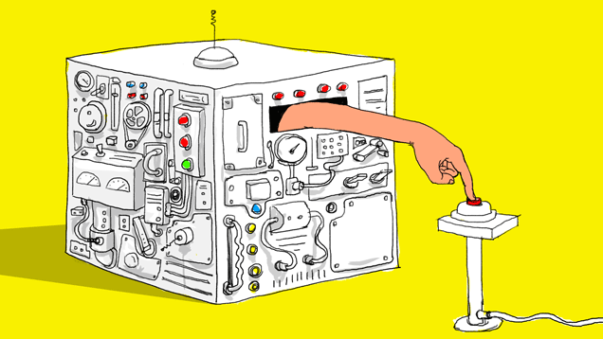
Current Implemented Solution
Problems with the deep learning approach
Training a model on a single welding line for a specific workpiece requires thousands of images
Faurecia is a worldwide auto-parts maker having thousands of workpieces in their inventory
Each new workpiece requires a new model to train
Large scale adoption requires labeling millions of images regularly
Manual Labeling is not a feasible option

Slide 15
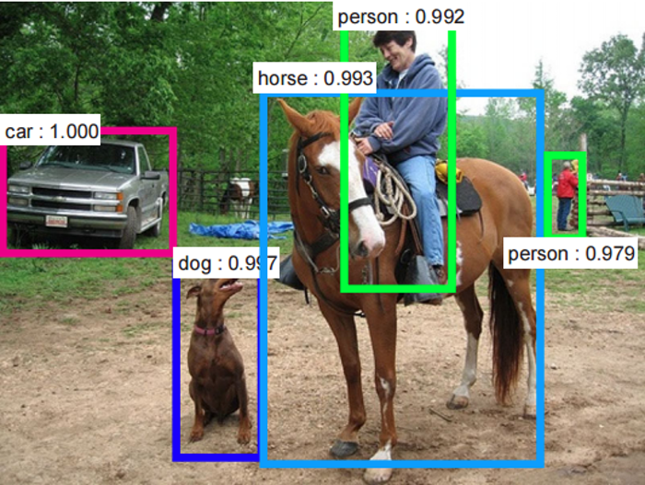
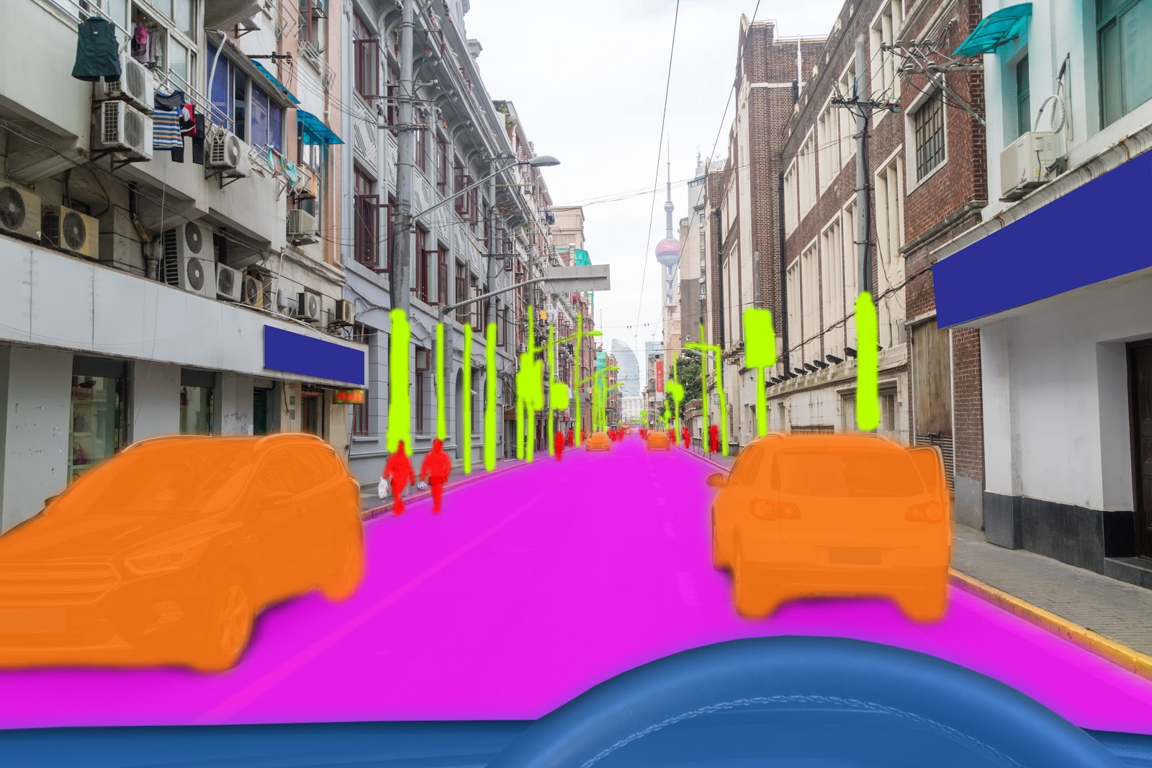
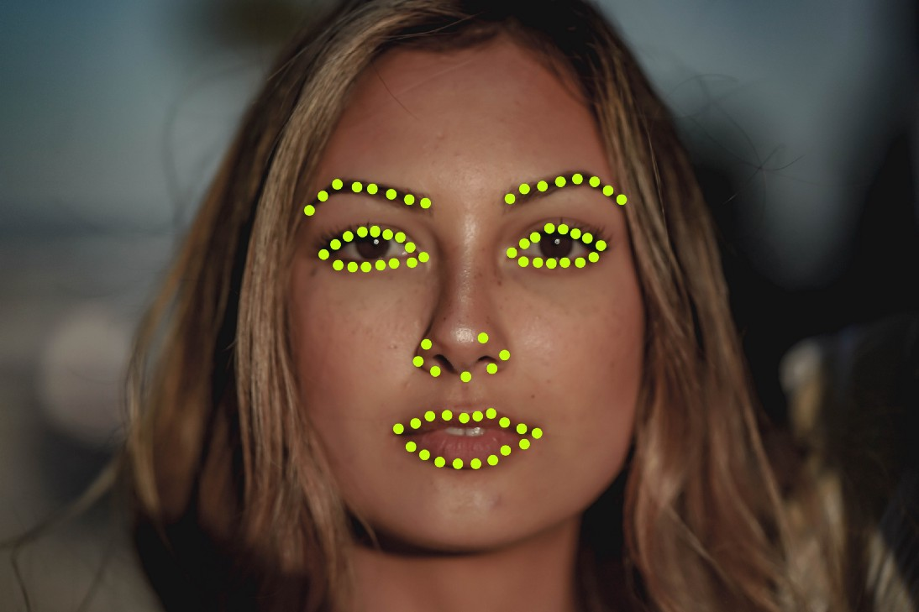
Labeling In Deep Learning
In deep learning, data labeling is the process of identifying raw data and adding meaningful labels to provide context so that the model can learn from it
Labeling techniques include:
Bounding Boxes
Semantic Segmentation
Point Annotation

Slide 16
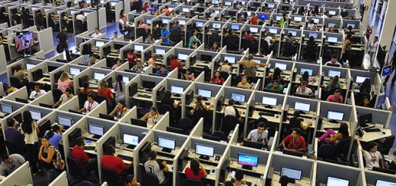
Manual and Automatic Labeling
Manual Labeling
Highly scalable (Workers need zero experience)
Highly flexible (Humans can label anything)
High Cost
Automatic Labeling
Faster than humans
Cheaper than humans
Low flexibility (New classes need time to be learned)

Slide 17
Project’s Objectives

Slide 18
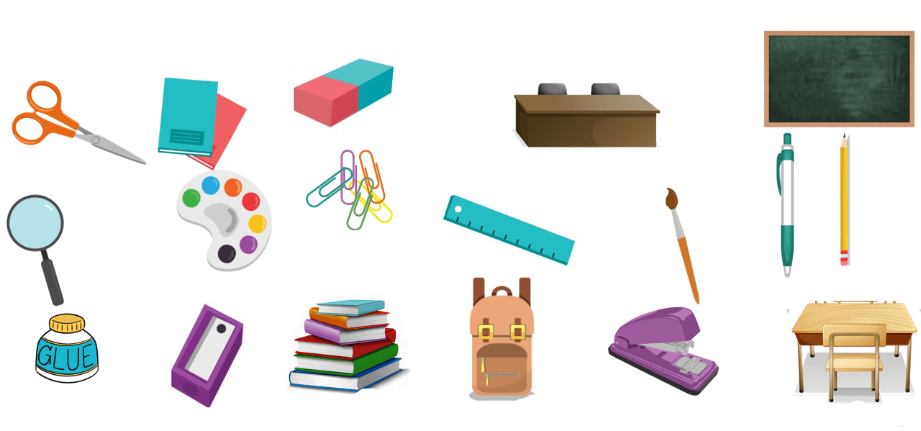

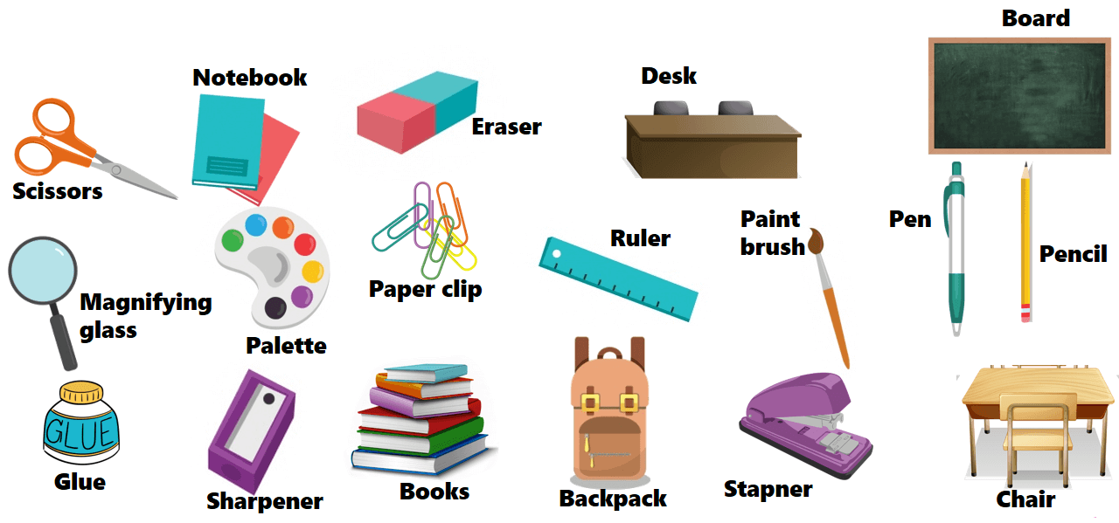
Objectives
Develop an algorithm that can classify images and label them automatically
Design and Develop an interface to operate this algorithm
Unlabeled Images
Algorithm
Labeled Images

Slide 19
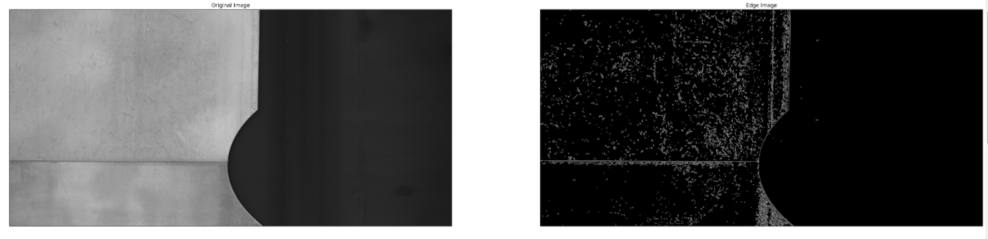
Our Solution
Develop a state of the art welding model capable of detecting welding lines
Develop an image processing algorithm using Canny edge detector to detect welding lines on images
Run these 2 algorithms on unlabeled images and:
If they give the same answer
Label the image as they predicted (Certain Images)
Else
Leave the image for manual labeling (Uncertain Images)

Slide 20
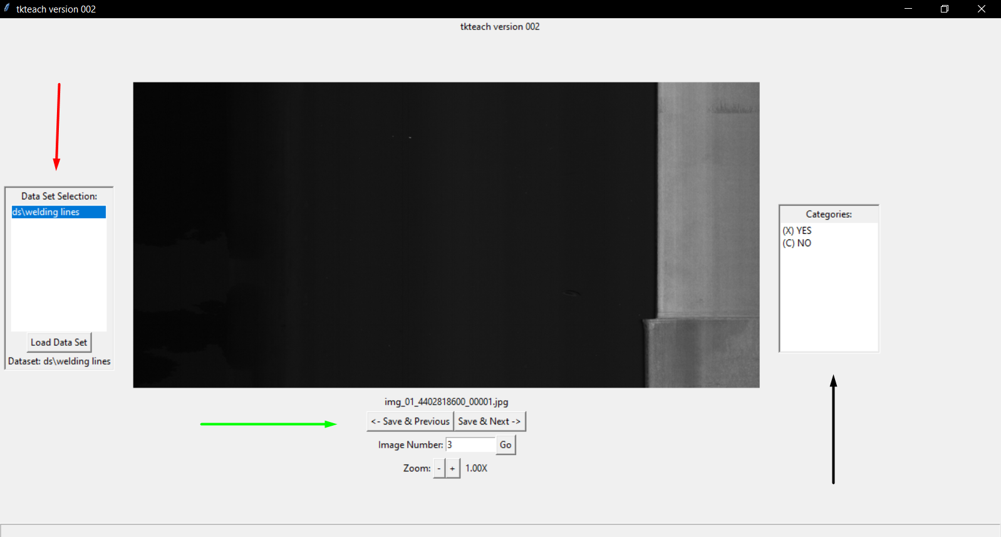
Our Solution
4. Design an interface for easy labeling uncertain images
5. Design a main interface to easily access the whole algorithm

Slide 21

Challenges
Deep Learning Model
Achieving a high level of generalization to label correctly across a wide range of:
Workpieces
Surfaces
Lighting conditions
Canny Edge Detector
Noisy images have low contrast making edge detection for canny almost impossible
Automating input parameter for Canny based on image brightness

Slide 22
Solution’s Architecture

Slide 23
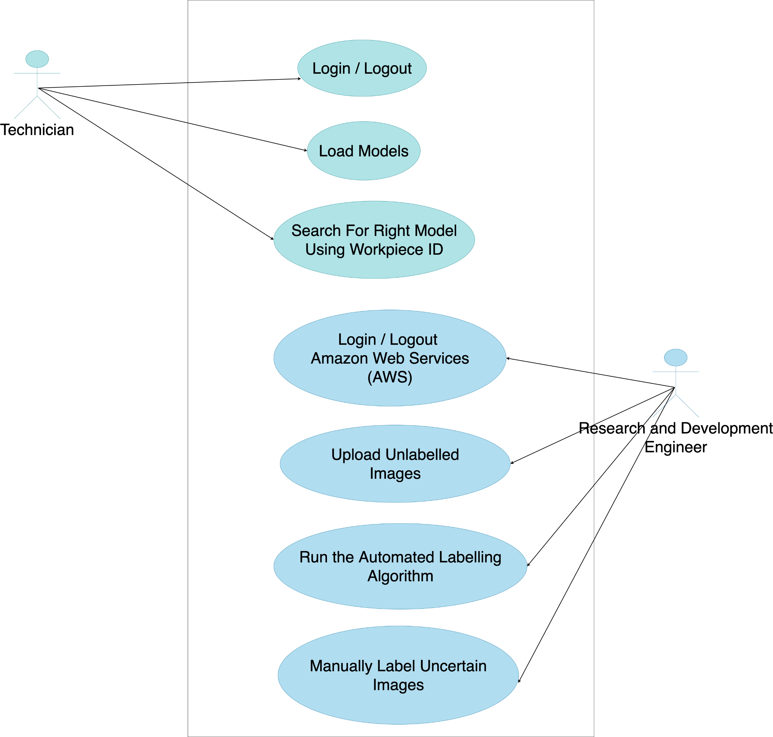
Scenarios

Slide 24
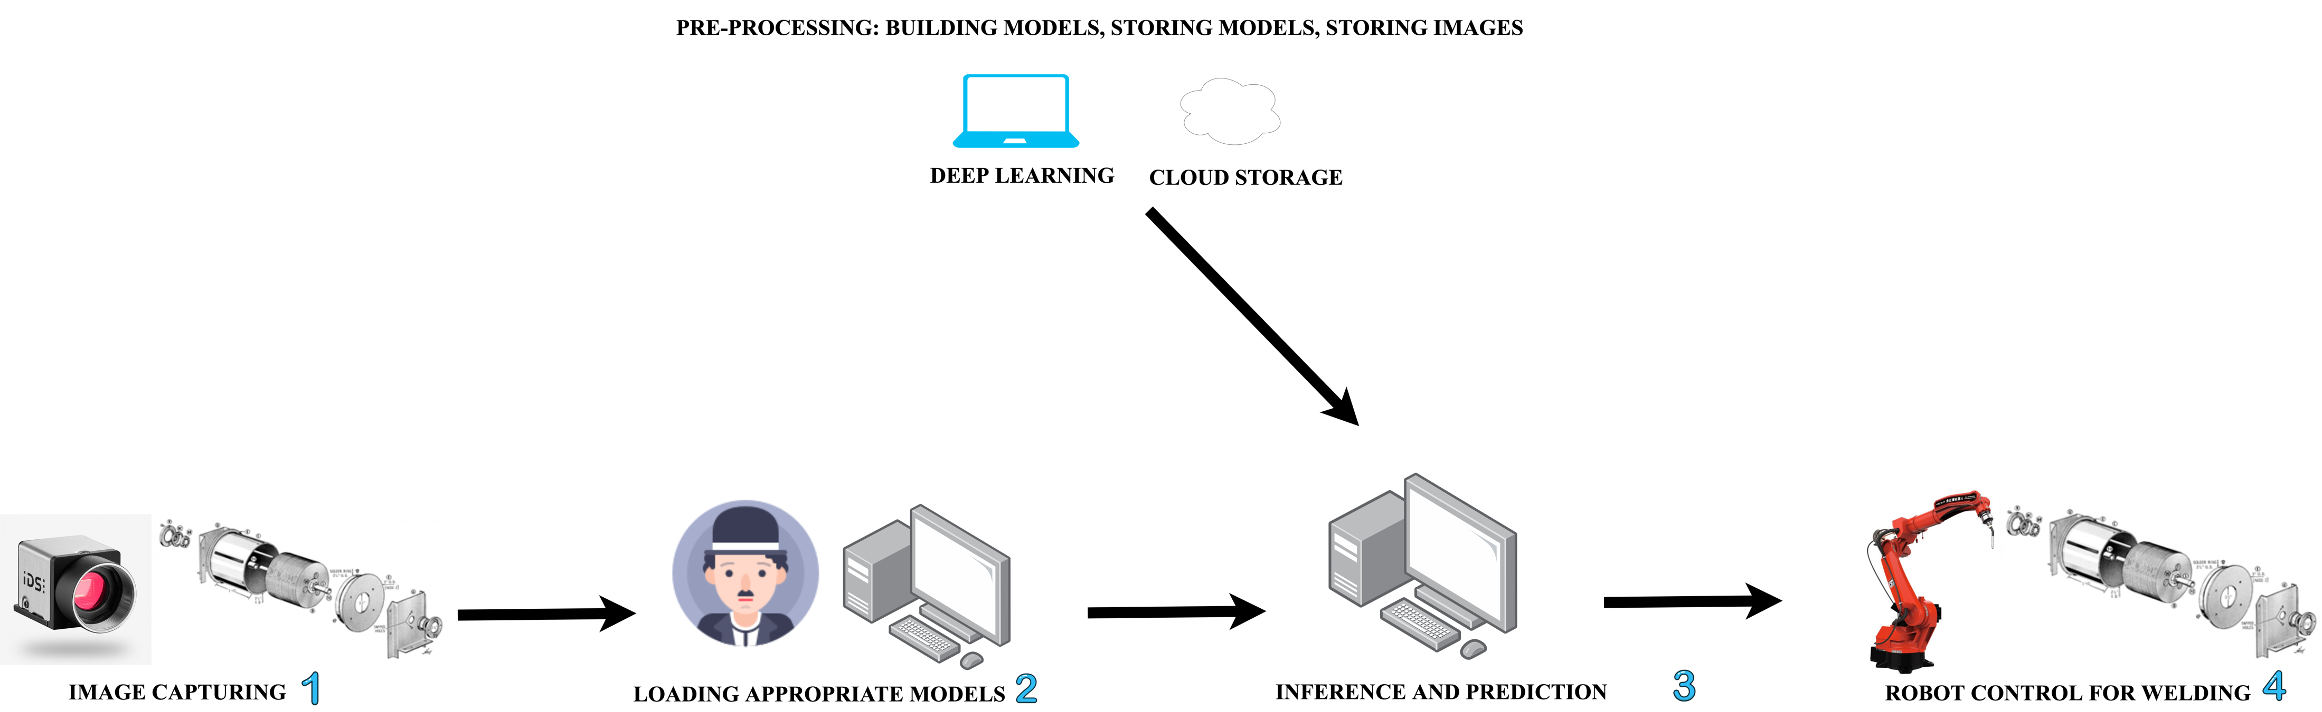
Hardware Architectural Diagram

Slide 25
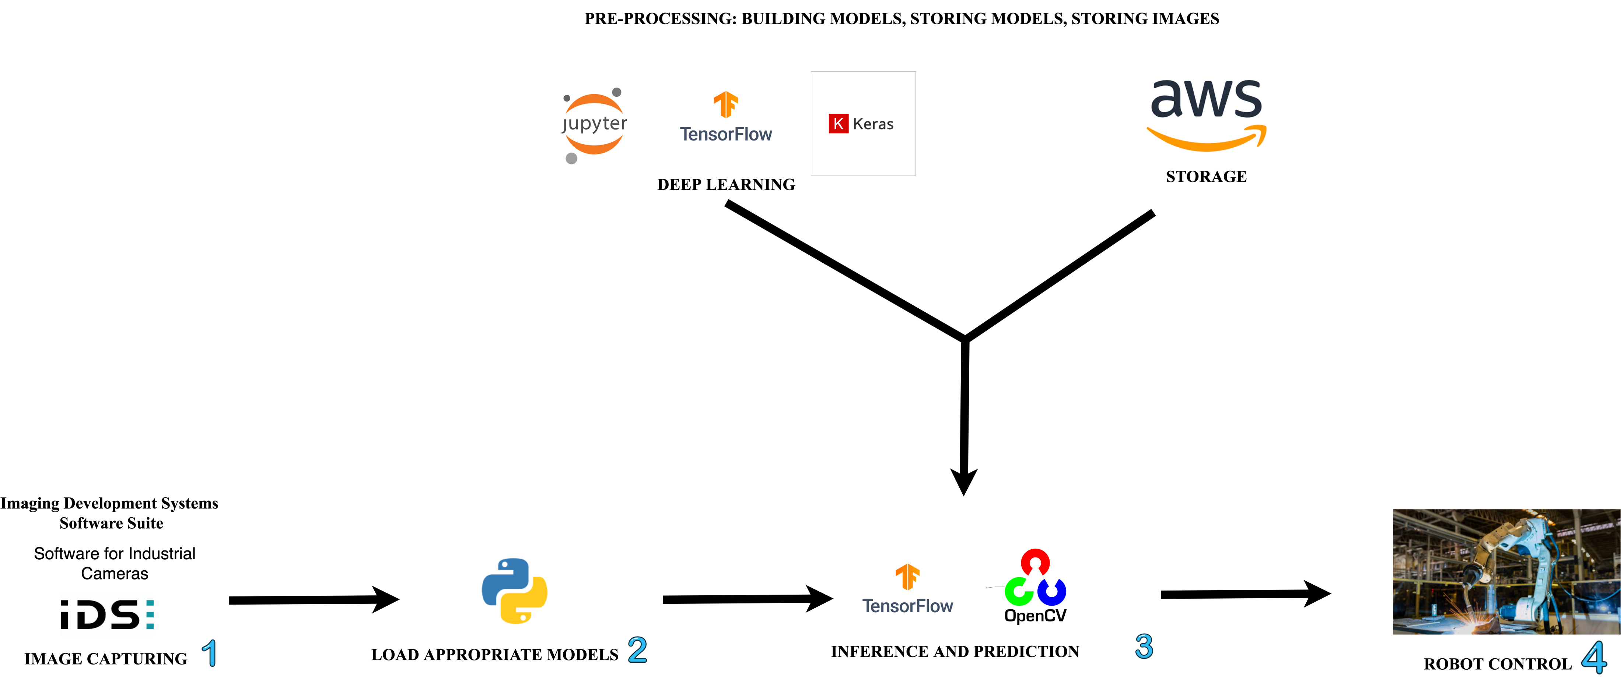
Software Architectural Diagram

Slide 26
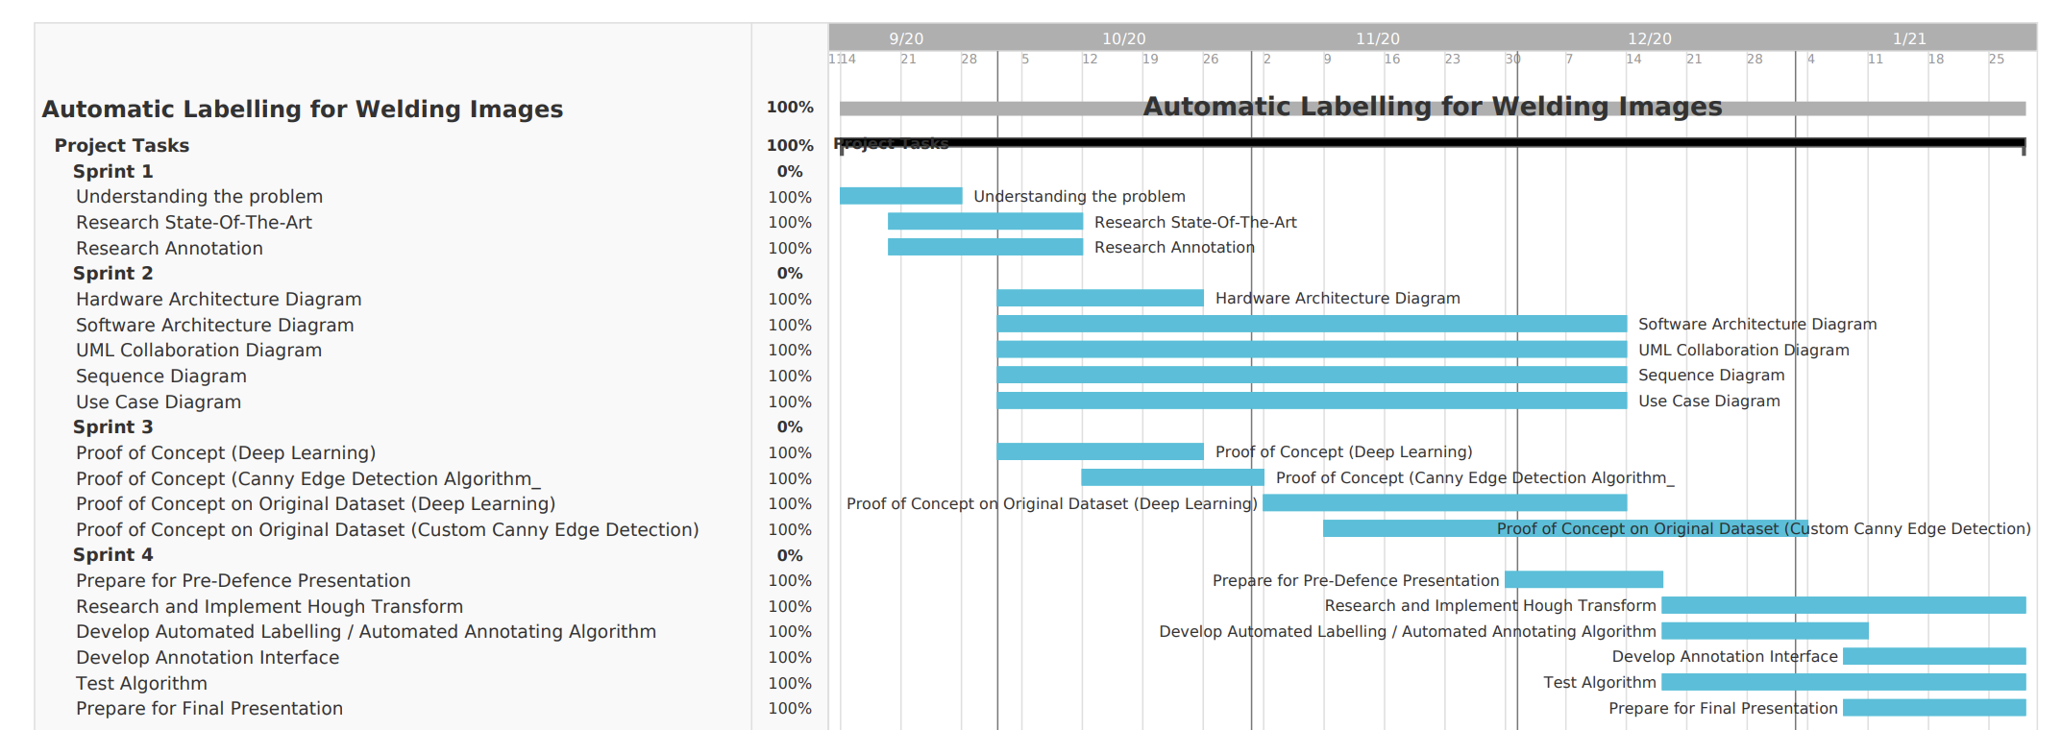
GANTT (Agile Methodology)

Slide 27
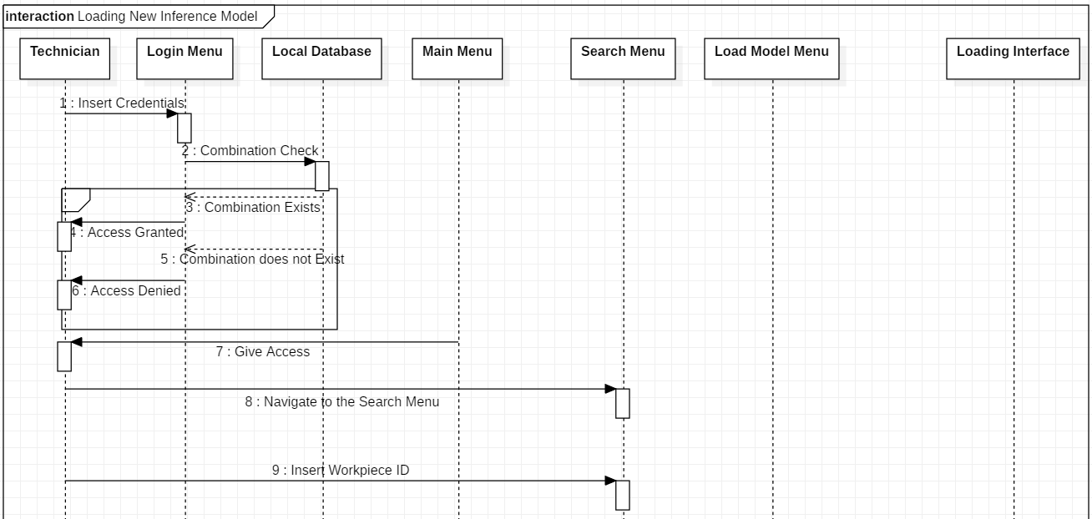
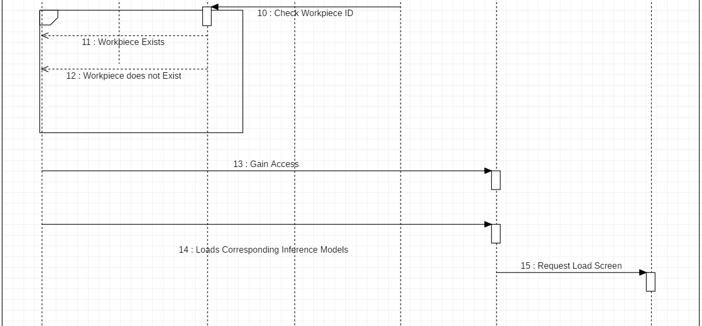
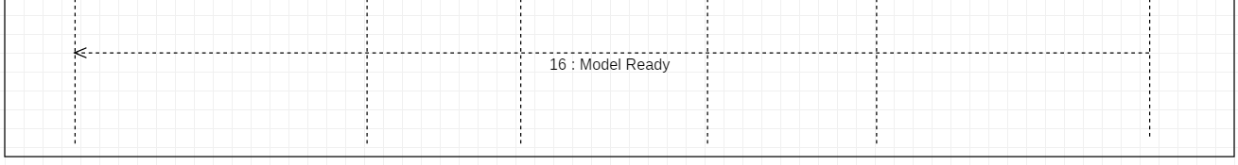
Sequence Diagram
Inference interface:
A new workpiece just arrived to the welding station
The technician checks the workpiece’s serial number

Slide 28
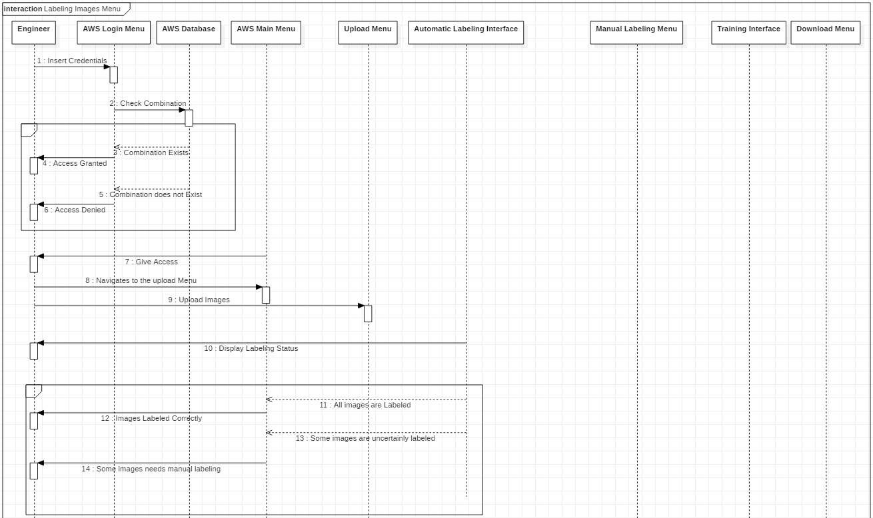
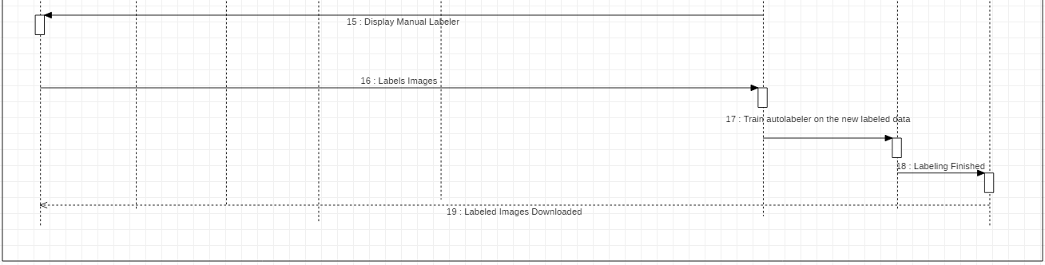
Sequence Diagram
Labeling interface:
The engineers have collected thousands of images of a new workpiece
They need to label all that data to train their new models

Slide 29
Proof Of Concept

Slide 30
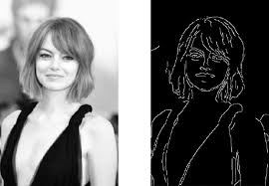
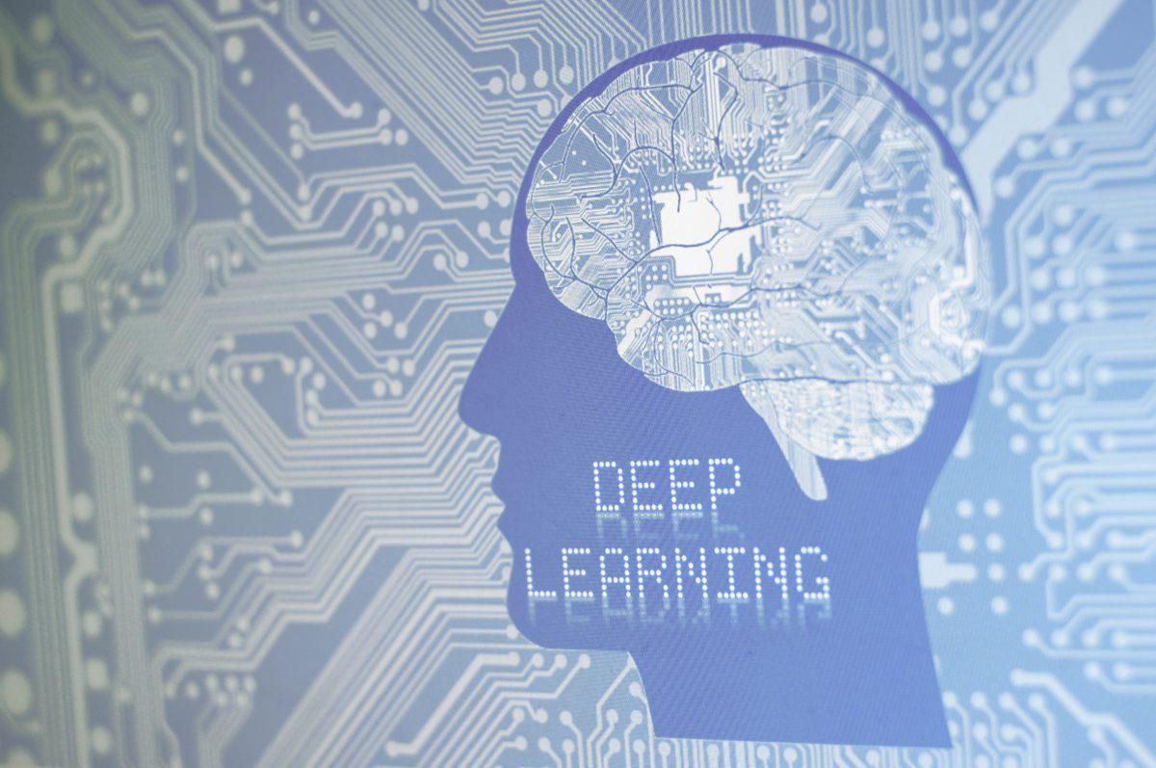
Overview
Canny Edge Detector
Improved Canny Algorithm
Improved Canny Results
Improved Canny Demo
Deep Learning Models
Xception Code and Results
ResNet Code and Results
Inception Code and Results
Inception Demo

Slide 31
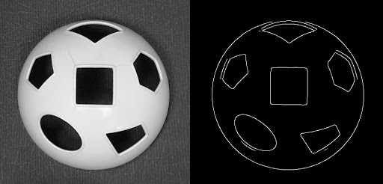
Canny Edge Detector
The Canny edge detector is an edge detection operator that uses a multi-stage algorithm to detect a wide range of edges in images

Slide 32
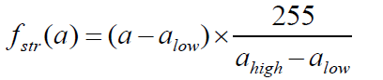
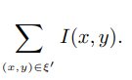
Improved Canny Algorithm
Increase the Image’s Contrast
Quantify image’s brightness by summing the image’s pixels
Map the brightness score to the low and high threshold of the Canny Function
Apply Canny
Apply Hough Transform to bolden the edges

Slide 33
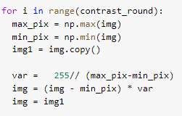
Improved Canny Algorithm
Increase the Image’s Contrast
Quantify image’s brightness by summing the image’s pixels
Map the brightness score to the low and high threshold of the Canny Function
Apply Canny to the image
Apply Hough Transform to bolden the edges

Slide 34
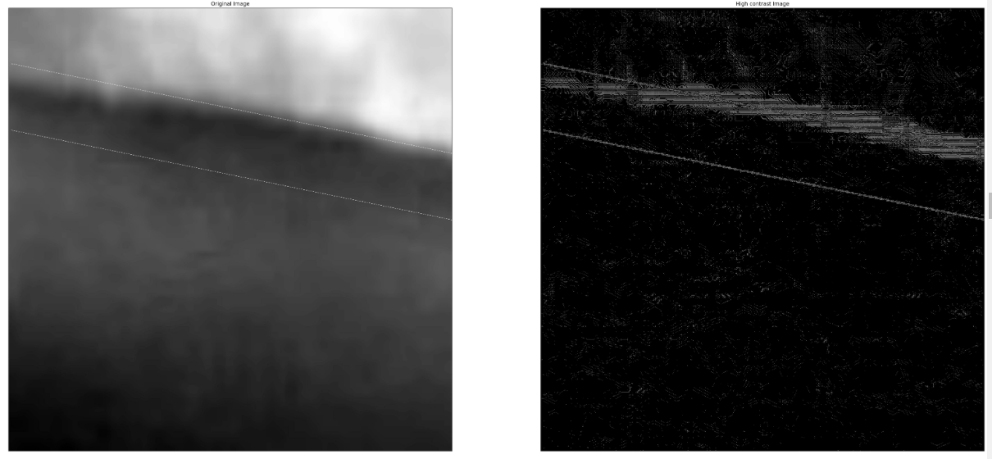
Improved Canny Result
99% Accuracy on esthetic dataset (Found on the web)
50% to 70% Accuracy on the real dataset (Provided by Faurecia)
Faurecia’s Dataset
Unlabeled Images

Slide 35
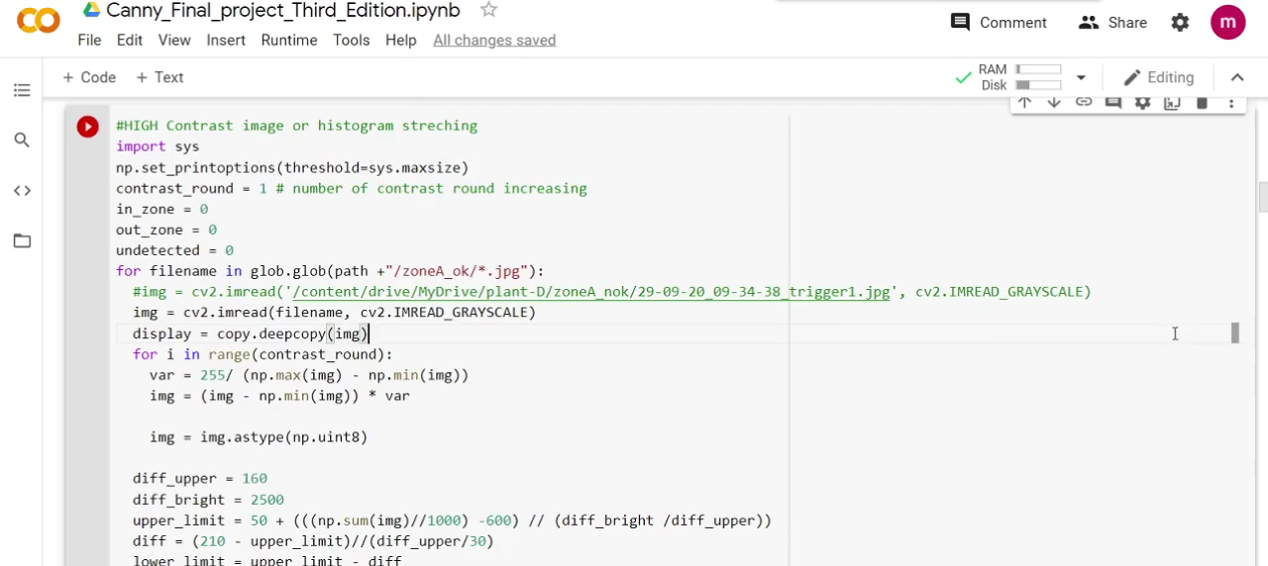
Demo For Improved Canny

Slide 36
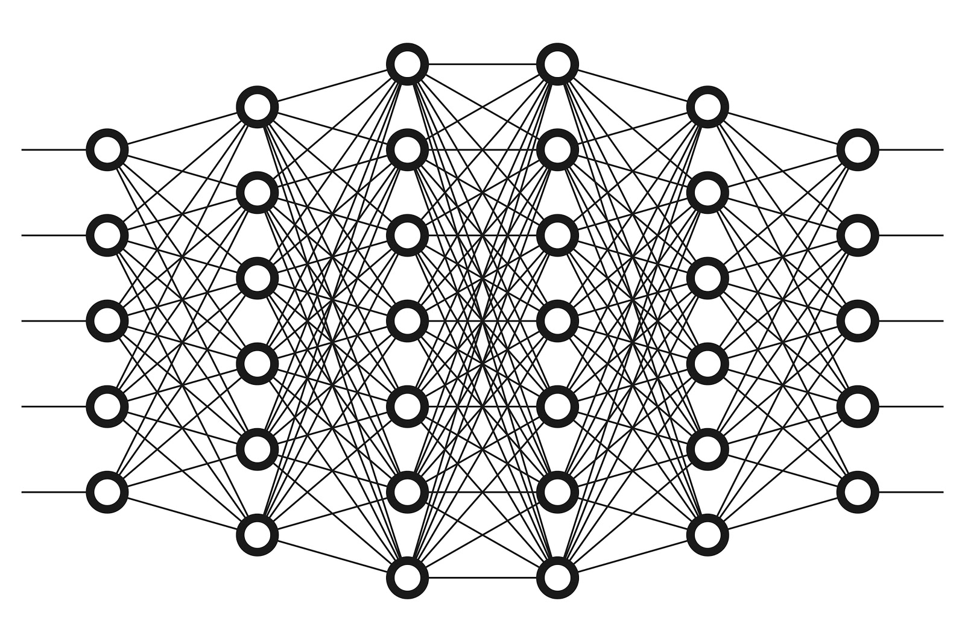
Deep Learning Algorithm
Transfer Learning
Xception, ResNet, Inception V3
Trained on ImageNet weights
Image Size = 140 x 155

Slide 37
Deep Learning Algorithm
Retrain all layers of base model
Class weights (NOT-OK:10.0, OK:1.0)
100 epochs
Save the best model (based on val_accuracy)

Slide 38
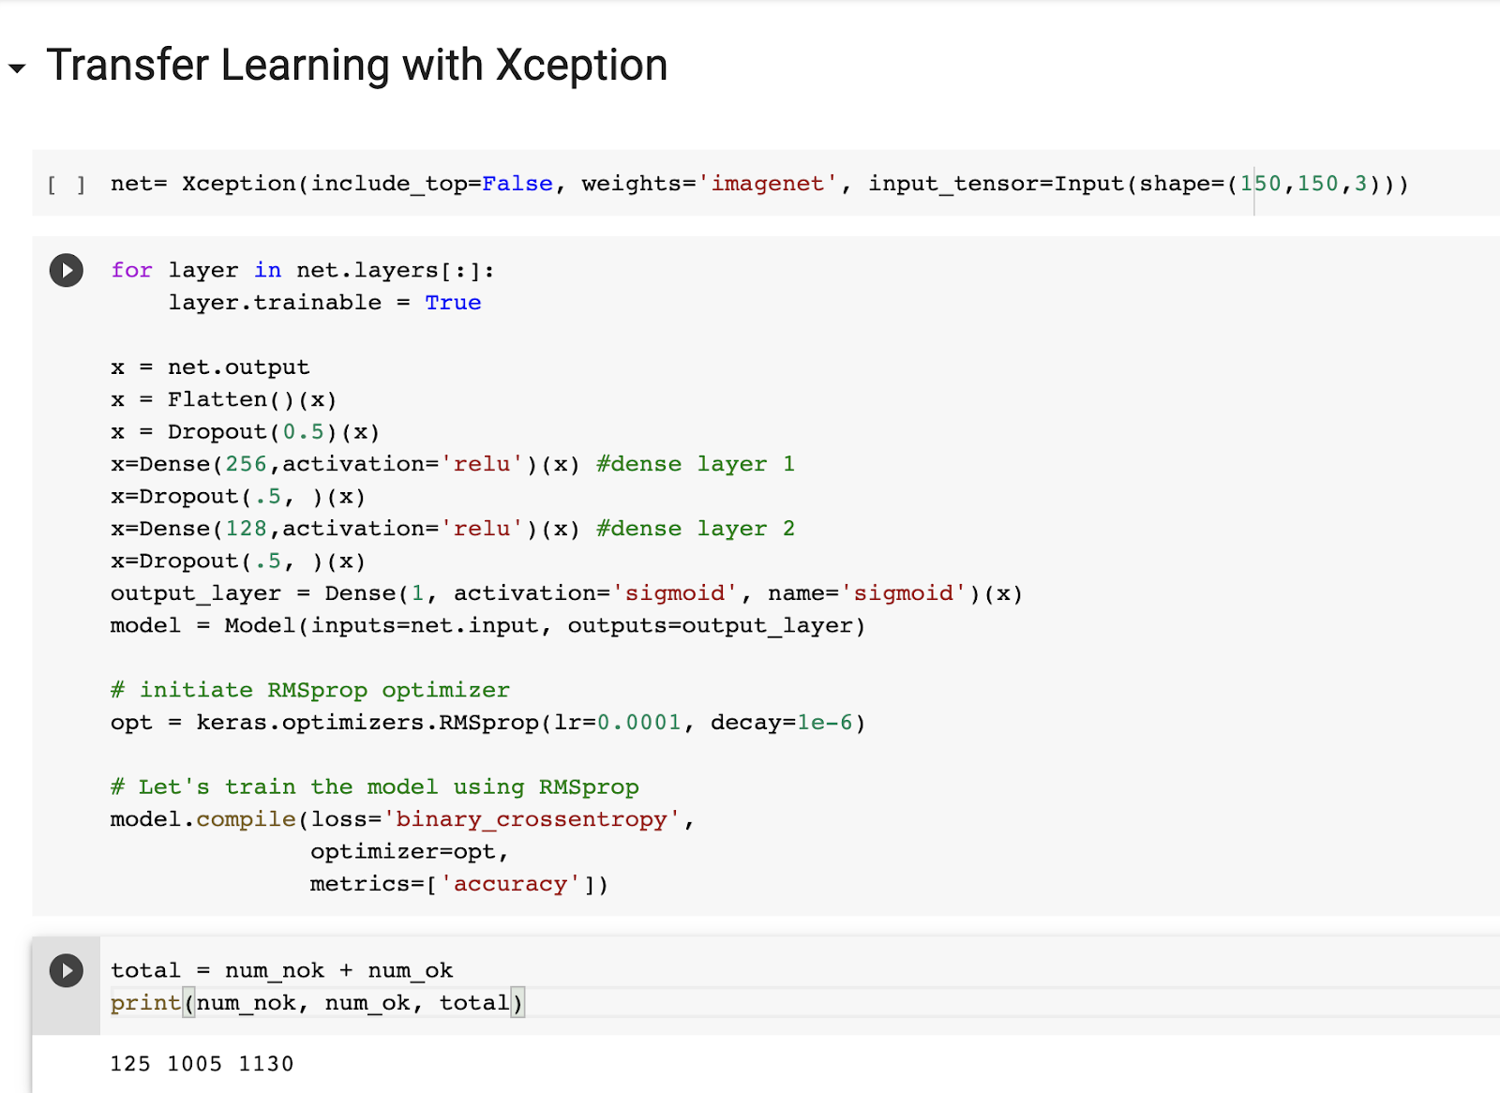
Xception Code

Slide 39
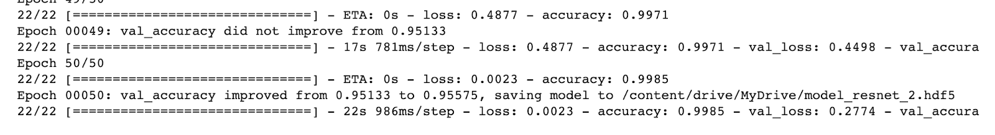
Xception Results
Accuracy on Validation Set: 95.58%

Slide 40
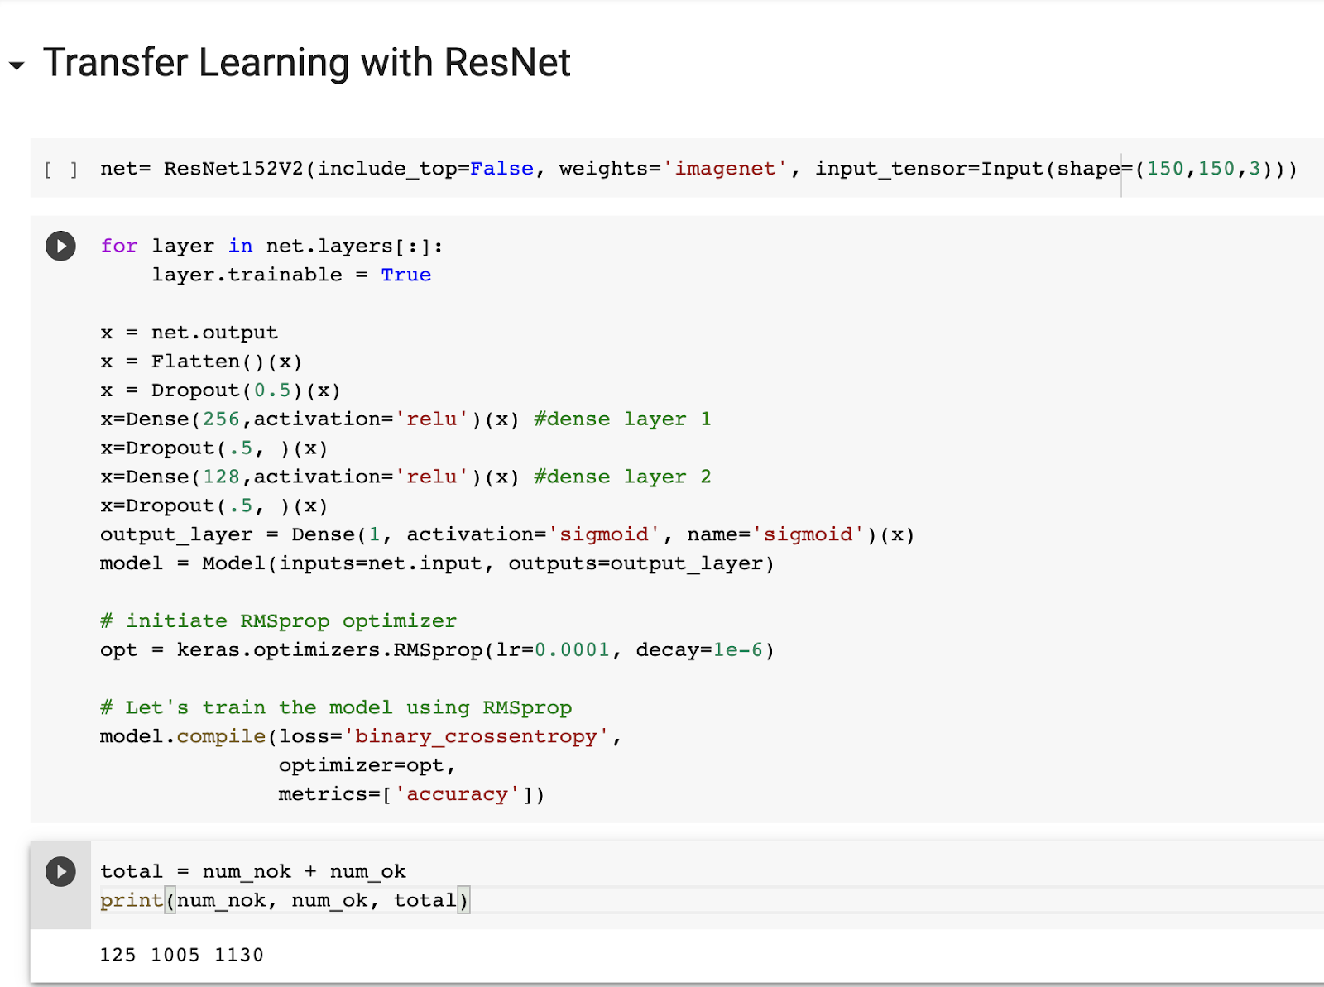
ResNet Code

Slide 41
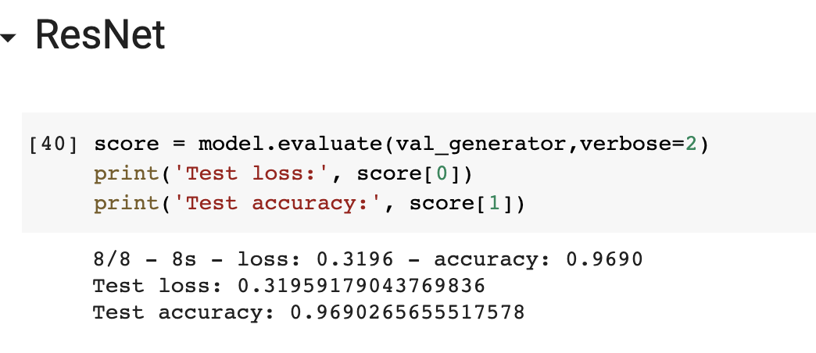
ResNet Results
Accuracy on Validation Set: 96.90%

Slide 42
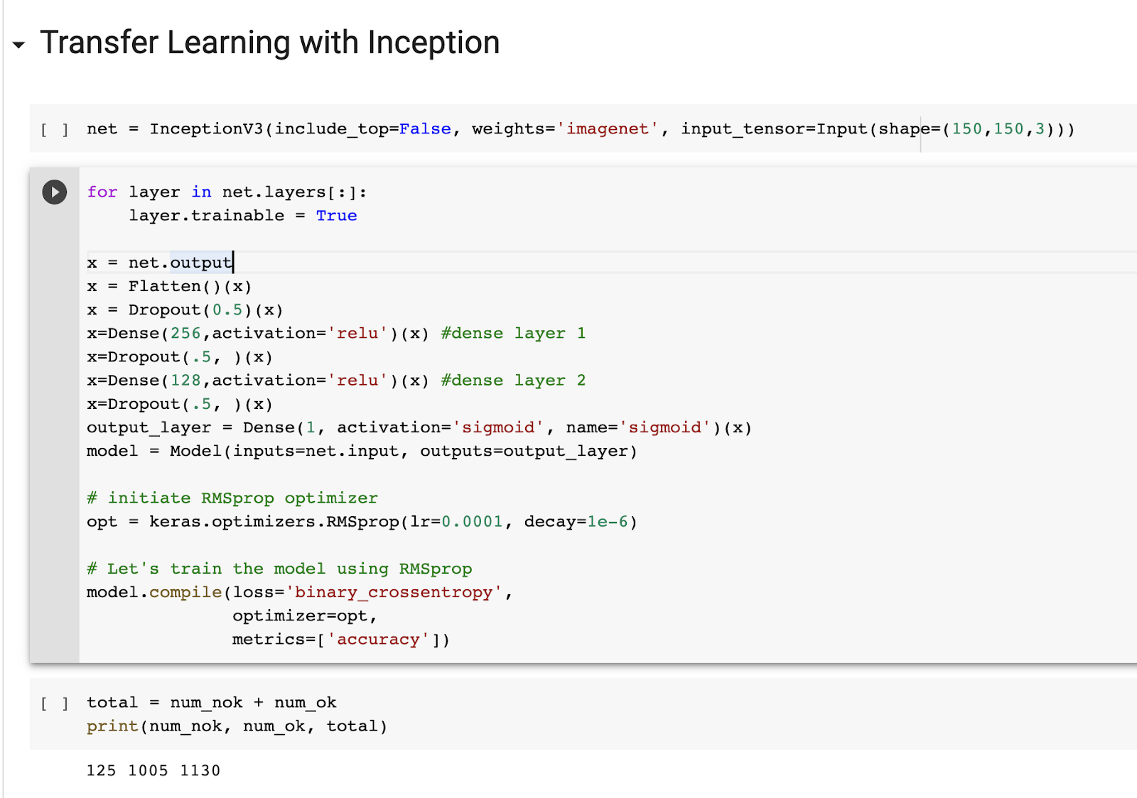
Inception Code

Slide 43
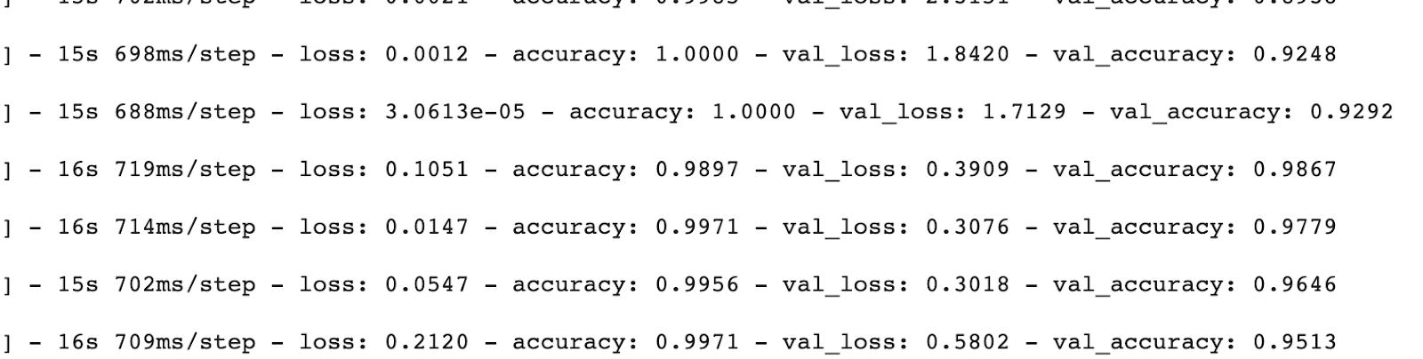
Inception Results
Highest Ever Accuracy: 98.67%

Slide 44
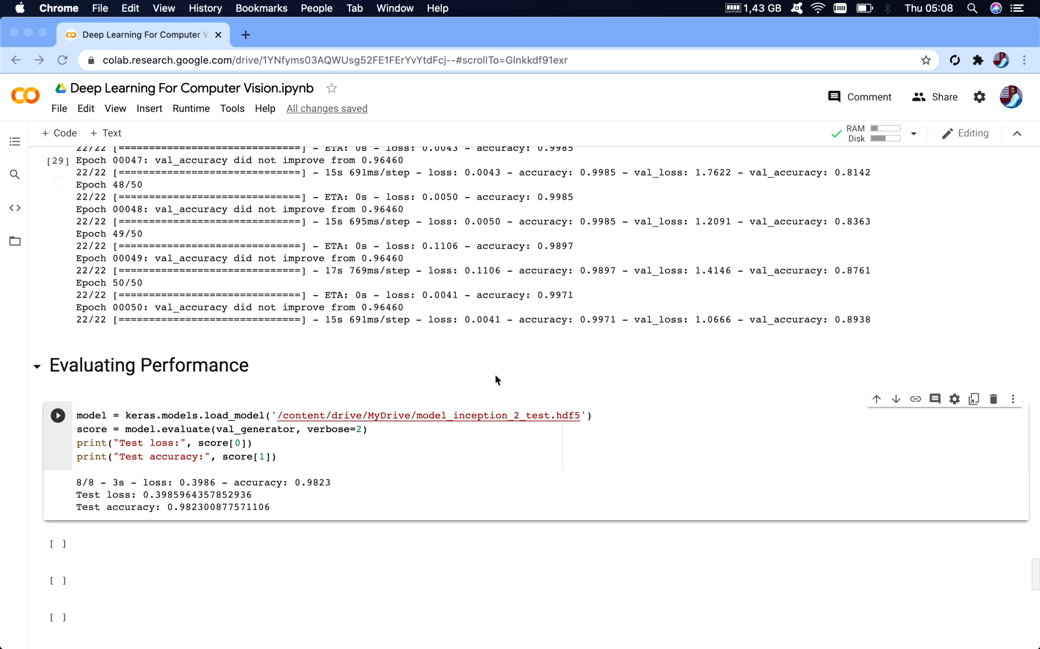
Demo For Inception Deep Learning Model

Slide 45
Live Demo

Slide 46
Summary Of Contribution And Results
First Contribution:
Narrowing The Problem
Researched image Labeling vs 3D Modeling Labeling (CATIA, AutoCAD)
Researched Automatic vs Manual Labeling
Researched Different Annotation Techniques (Bounding Boxes, Semantic Segmentation…)
Researched Best Open Source Platforms for Data Annotation
Studied different Machine learning Techniques (Support Vector Machine , K-Nearest Neighbor, Deep Boltzmann Machines)
Second Contribution:
Researched Image Filters (Box-filtered, Gaussian…)
Researched Kernel Convolution
Researched Sobel and Canny Edge Detection (Hysteresis Thresholding)
Studied Machine Learning based annotators
Labeled a welding line dataset found on the web
Developed an manual labeling interface (Version 1)
Implemented Different Models to classify the images (Inception, MobileNet…)
Third Contribution:
Developing Adaptive parameters for Canny based on image brightness (Version 1)
Combining Canny with Hough Transform (Version 1)
Fourth Contribution:
Training and testing different deep learning models (Version 2)
Applying different crops on the dataset
Fifth Contribution:
Designing an Easy to use interface (Version 1)
Manual labeler interface (Version 2)
Designing an auto labeler with above 99% accuracy (Version 1)

Slide 47
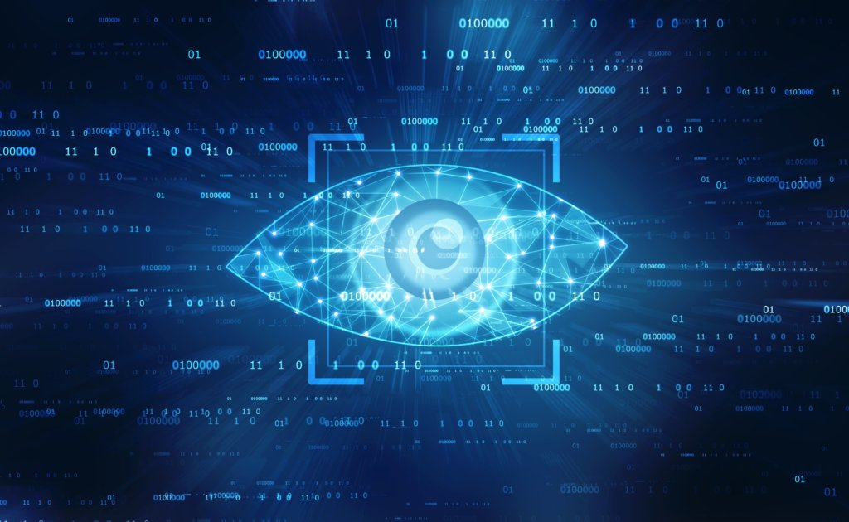
Conclusion
What did we learn?
Technical
Image Processing
Contrast, Brightness, Sharpening adjustment…
Pixel Wise operations
Developing Filters
Deep Learning
Develop custom Models for edge detection in:
Low and extremely high lighting conditions
High Noise
High Reflection
Generalization across Huge datasets from different environments
Soft skills
Team work
Time Management (Weekly reports)
Applying Agile Methodology to our framework

Slide 48
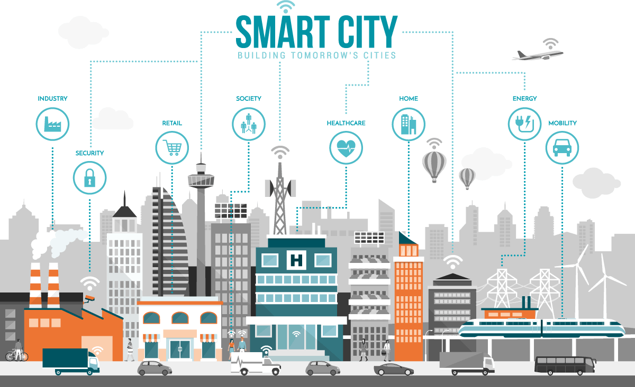
Conclusion
How will this experience help in the IOT/Smart City era?
Practical Experience in Computer Vision
Design and Development of Auto Labeler to help with the massive data of Smart cities

Slide 49
References
Statistics
United States Manufacturing Production, Trading Economics. 2018. tradingeconomics.com
United States Manufacturing Production, Trading Economics. 2018. tradingeconomics.com
North American Robotics Market Sets New First Quarter Shipments Record. 2018. Robotics Industries Association (RIA) robotics.org.
2018 Automation Market Update. 2018. Association for Advancing Automation (A3) a3automate.org.
https://www.globenewswire.com/news-release/2020/11/23/2132105/0/en/Robotic-Welding-Market-to-Hit-USD-8-31-Billion-by-2027-Growing-Automotive-Sector-to-Stimulate-Demand-Fortune-Business-Insights.html
https://ijmme.springeropen.com/articles/10.1186/s40712-015-0042-y
https://cdn.intechopen.com/pdfs/405.pdf
https://insights.globalspec.com/article/11712/the-robotic-welding-industry-today

Slide 50
References
Data Annotation
https://medium.com/vsinghbisen/why-data-annotation-is-important-for-machine-learning-and-ai-5e647637c621
https://hackernoon.com/illuminating-the-intriguing-computer-vision-uses-cases-of-image-annotation-w21m3zfg
https://hackernoon.com/the-best-image-annotation-platforms-for-computer-vision-an-honest-review-of-each-dac7f565fea
https://en.wikipedia.org/wiki/List_of_manual_image_annotation_tools
https://kili-technology.com/blog/what-is-image-annotation-in-deep-learning/
https://abelling.com/comparison-of-different-annotation-tools-for-computer-vision/
https://medium.com/anolytics/what-are-the-limitations-of-automatic-image-annotation-vs-manual-a8ff7edb3152
Data Representation
Li Mengge, Wang Jihua,. Application of Convolutional Neural Network in B-rep Models Classification 2018
https://www.cadinterop.com/en/your-needs/step/different-geometry-types-and-formats-in-cad.html
https://all3dp.com/3d-file-format-3d-files-3d-printer-3d-cad-vrml-stl-obj/#:~:text=We%20simply%20explain%20the%20most,OBJ%2C%20FBX%2C%20COLLADA%20etc.
https://old.opencascade.com/doc/occt-6.7.0/overview/html/occt_brep_format.html
https://all3dp.com/3d-file-format-3d-files-3d-printer-3d-cad-vrml-stl-obj/#:~:text=We%20simply%20explain%20the%20most,OBJ%2C%20FBX%2C%20COLLADA%20etc.
https://help.actify.com/display/SF1100/B-rep+and+Tessellation
https://en.wikipedia.org/wiki/Tessellation_(computer_graphics)
https://en.wikipedia.org/wiki/Boundary_representation

Slide 51
References
Machine Learning
https://medium.com/@yu4u/why-mobilenet-and-its-variants-e-g-shufflenet-are-fast-1c7048b9618d
https://mc.ai/deep-learning%E2%80%8A-%E2%80%8Adeep-boltzmann-machine-dbm/
https://machinethink.net/blog/mobile-architectures/
https://towardsdatascience.com/3-small-but-powerful-convolutional-networks-27ef86faa42d
https://www.hindawi.com/journals/cin/2018/7068349/
https://hackernoon.com/what-is-a-capsnet-or-capsule-network-2bfbe48769cc
https://medium.com/swlh/image-classification-using-machine-learning-and-deep-learning-2b18bfe4693f
https://dl-acm-org.ezproxy.utbm.fr/doi/10.1145/3094243.3094247#sec-ref
https://missinglink.ai/guides/computer-vision/neural-networks-image-recognition-methods-best-practices-applications/
https://towardsdatascience.com/3-small-but-powerful-convolutional-networks-27ef86faa42d
https://kili-technology.com/blog/automl-fast-labeling/
https://en.wikipedia.org/wiki/Automated_machine_learning
https://colab.research.google.com/github/tensorflow/docs/blob/master/site/en/tutorials/customization/custom_training_walkthrough.ipynb#scrollTo=sVNlJlUOhkoX
https://www.youtube.com/watch?v=inN8seMm7UI
https://medium.com/@yuraist/how-to-upload-your-own-dataset-into-google-colab-e228727c87e9
https://www.youtube.com/watch?v=Bn2gITckiD0
https://github.com/krishnaik06/Tomato-Leaf-Disease-Prediction
https://www.youtube.com/watch?v=sRFM5IEqR2w&list=PLzH6n4zXuckoRdljSlM2k35BufTYXNNeF&index=3

Slide 52
References
Datasets
https://www.kaggle.com/zhangyunsheng/defects-class-and-location
Label Tool
https://github.com/Serhiy-Shekhovtsov/tkteach
Images
https://processing.org/tutorials/color/
https://www.gamasutra.com/view/feature/3102/four_tricks_for_fast_blurring_in_.php?print=1
http://www.walrusvision.com/wordpress/introduction-to-edge-detection/
https://nrsyed.com/2018/02/18/edge-detection-in-images-how-to-derive-the-sobel-operator/
https://medium.com/@bdhuma/6-basic-things-to-know-about-convolution-daef5e1bc411
https://adobe-webplatform.github.io/filter-effects

Slide 53
Thank You, Any Questions?

